Slide 1

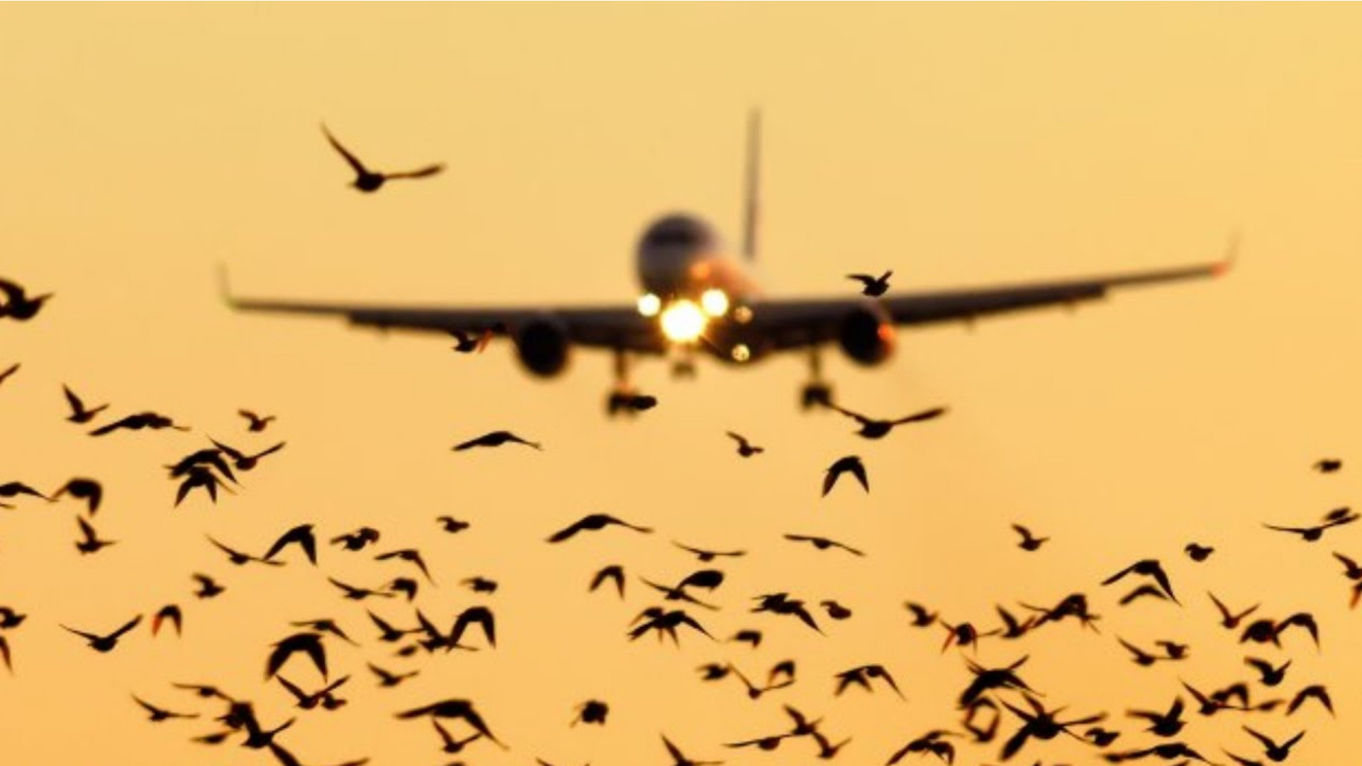
PROJECT 3: Data Visualization of Bird Strikes between 2000 – 2011 Domain: Transportation and Communication
PROJECT REPORT
Mentor:-
Saiprasad Kagne
Presented by:-
Priya Kumari

Slide 2
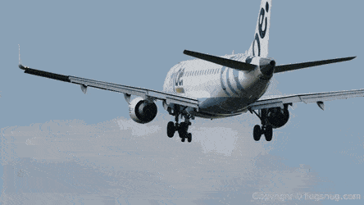
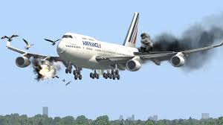
INTRODUCTION
Bird Strike: A collision between a bird and an aircraft (in flight mode/on a take-off/landing roll).
Is common and can be a significant threat to aircraft safety (several fatal accidents have already been reported).
Significant damage may be caused to smaller aircraft.
All aircraft, especially jet-engine ones, are vulnerable to the loss of thrust which can follow the ingestion of birds into engine air intakes.
Bird strikes may occur during any phase of flight, but are most likely during the take-off, initial climb, approach and landing phases due to the greater numbers of birds in flight at lower levels.

Slide 3
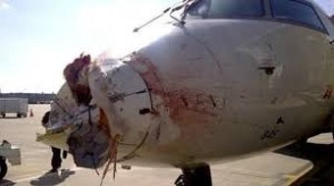
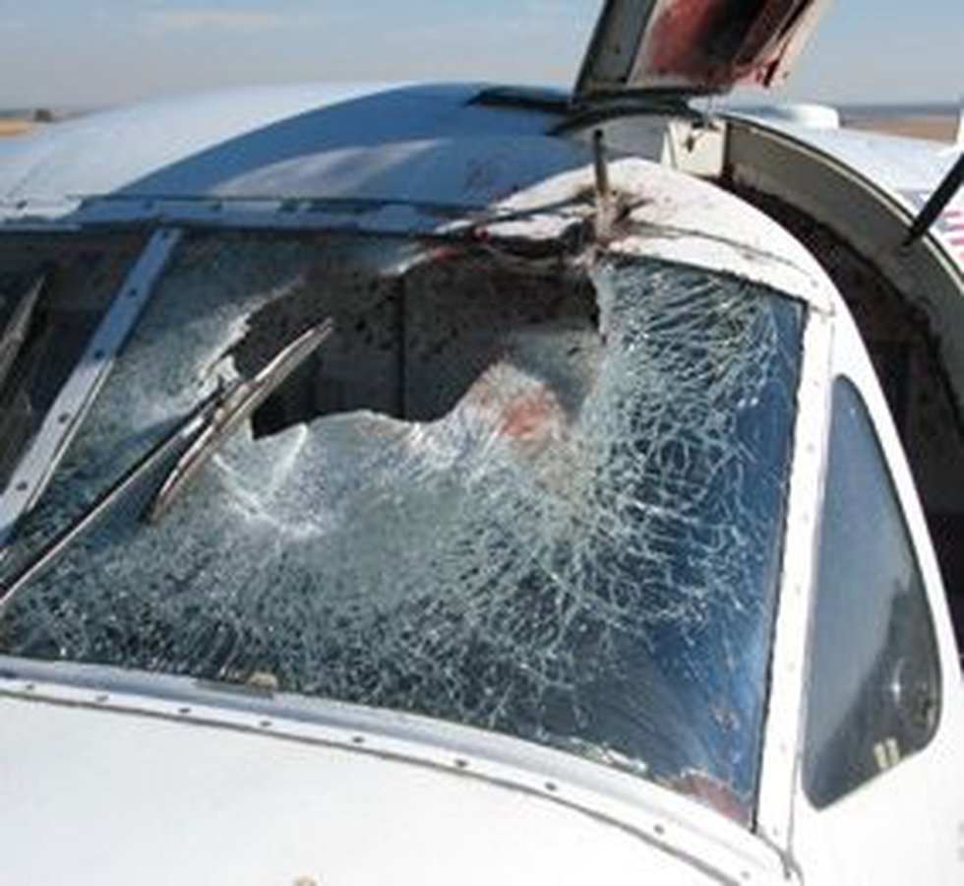
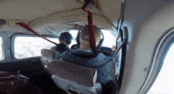
PROBLEM STATEMENT
Birds
+
planes
=
‘snarge’
Transport and communication: Crucial domain in the field of analytics.
Major Concerns: Environmental impact and Safety.
Why should we be worried? Bird and other wildlife strikes annually cause over $650 million in damage to U.S. civil and military aviation. They put the lives of aircraft crew members and their passengers at risk.
Important issue because of the ever-increasing amount of vehicles and people.
The most famous example of a dangerous bird strike was the 2009 “Miracle on the Hudson,” in which a US Airways jet was forced to land on the Hudson River after both engines of the aircraft ingested birds and failed

Slide 4
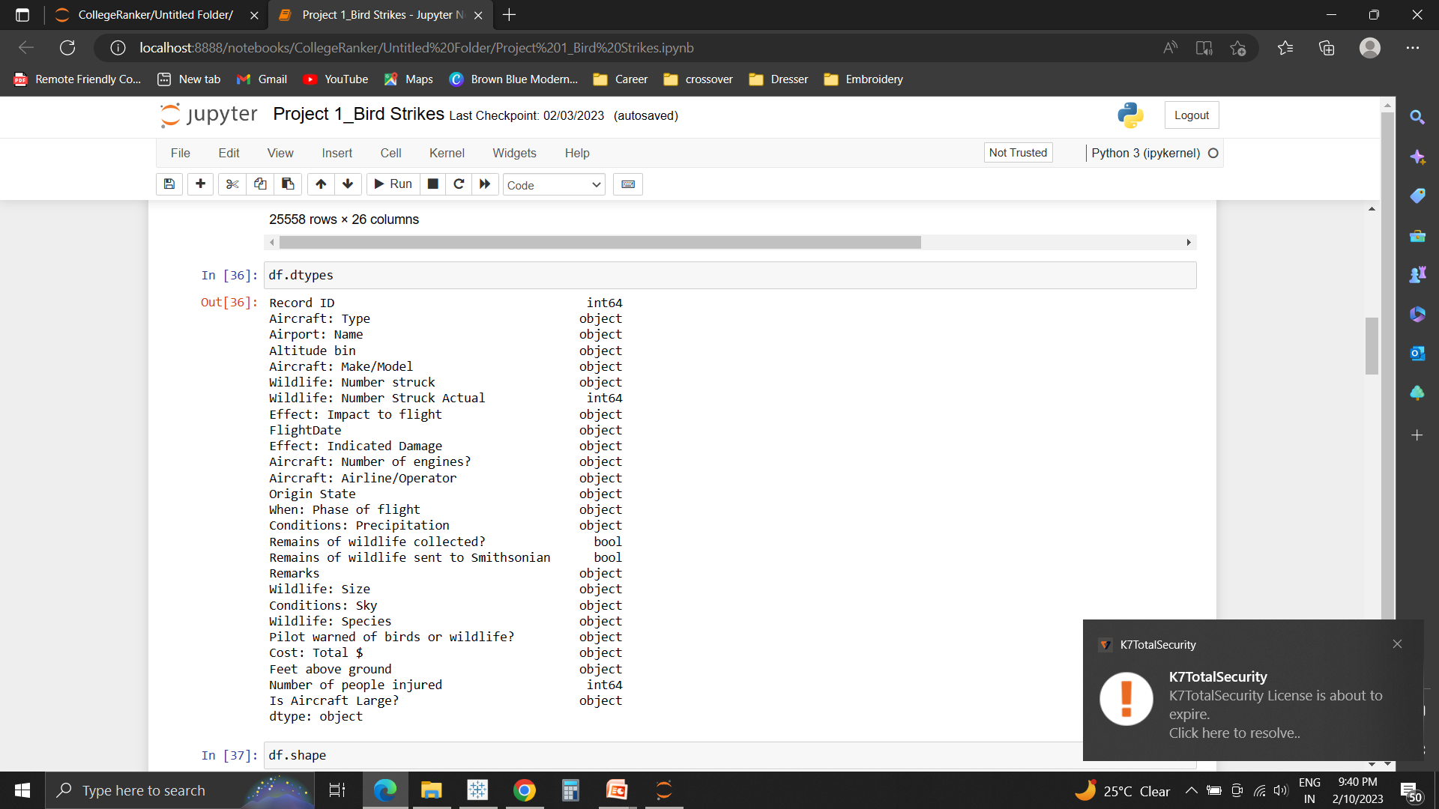


ANALYSIS:
Attributes present in the data
Our project visually depicts the data collected on Bird Strikes by Federal Aviation Administration (FAA) between 2000-2011.
Approach:
Python: Used for Data Cleaning
Tableau: For Visualization.
Based on the findings, a story was created.
For better understanding, the results were displayed on 3 dashboards of the story, listed as:
Direct/Indirect Impact on Mankind
Location, Air Service and Environmental Conditions
Study on Birds
Link to Dataset: https://docs.google.com/spreadsheets/d/1PF1PQ4qg4ySrtyOXiF6SFGX7P0Qfl_r/edit?rtpof=true&sd=true#gid=1443108996
Link to Python Notebook: https://colab.research.google.com/drive/1UUxDYFA0zJPxjnfJqMAudMl_E-0w4ghz
Link to Tableau: Story:https://public.tableau.com/app/profile/priya.kumari3667/viz/DataVisualizationofBirdStrikesinUSAccordingtoFAAbetween20002011/InrelationtoHumans

Slide 5
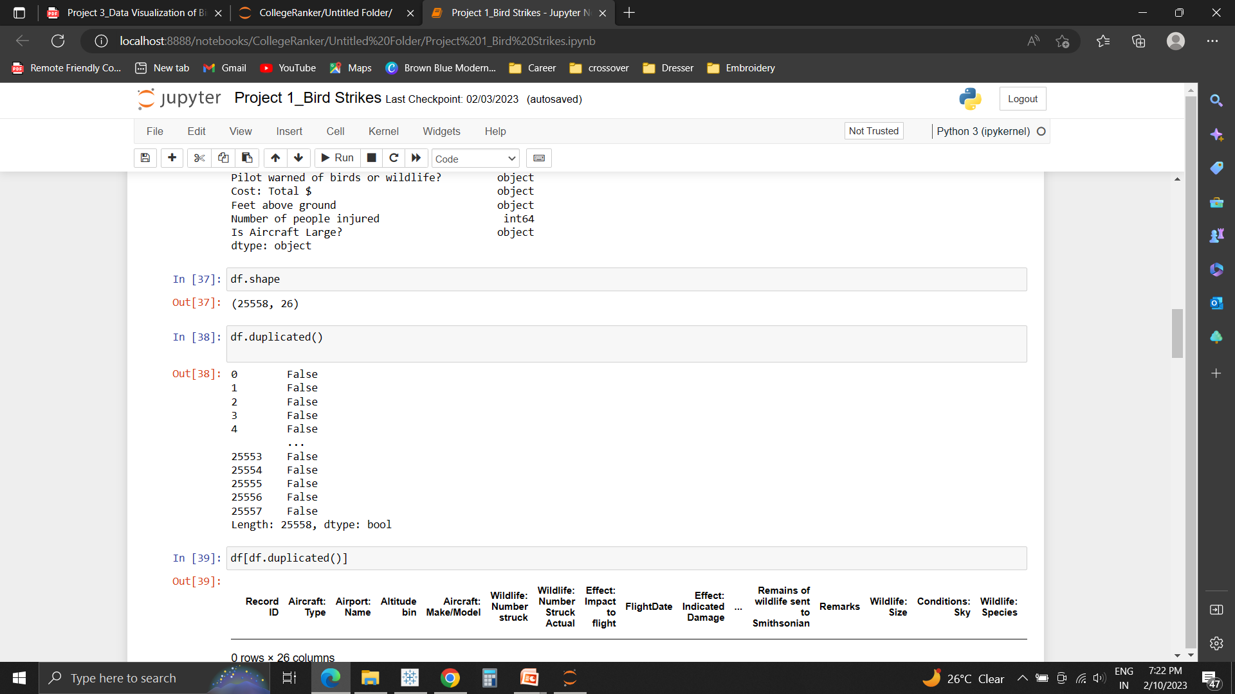
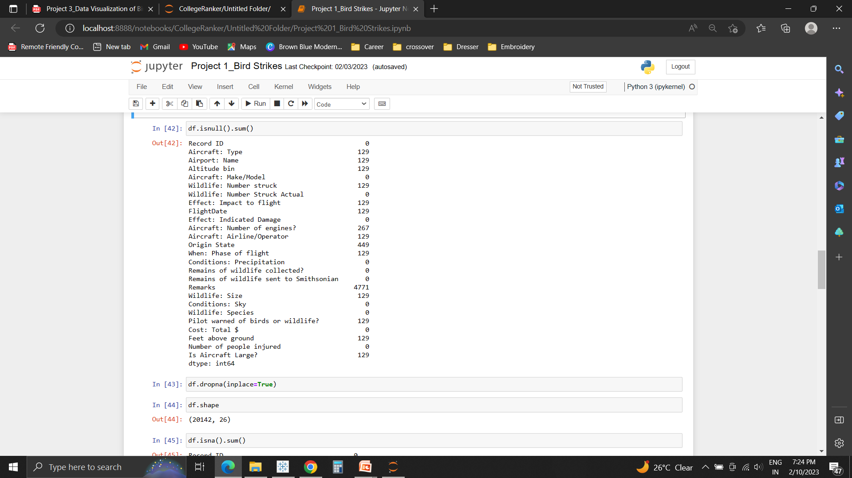
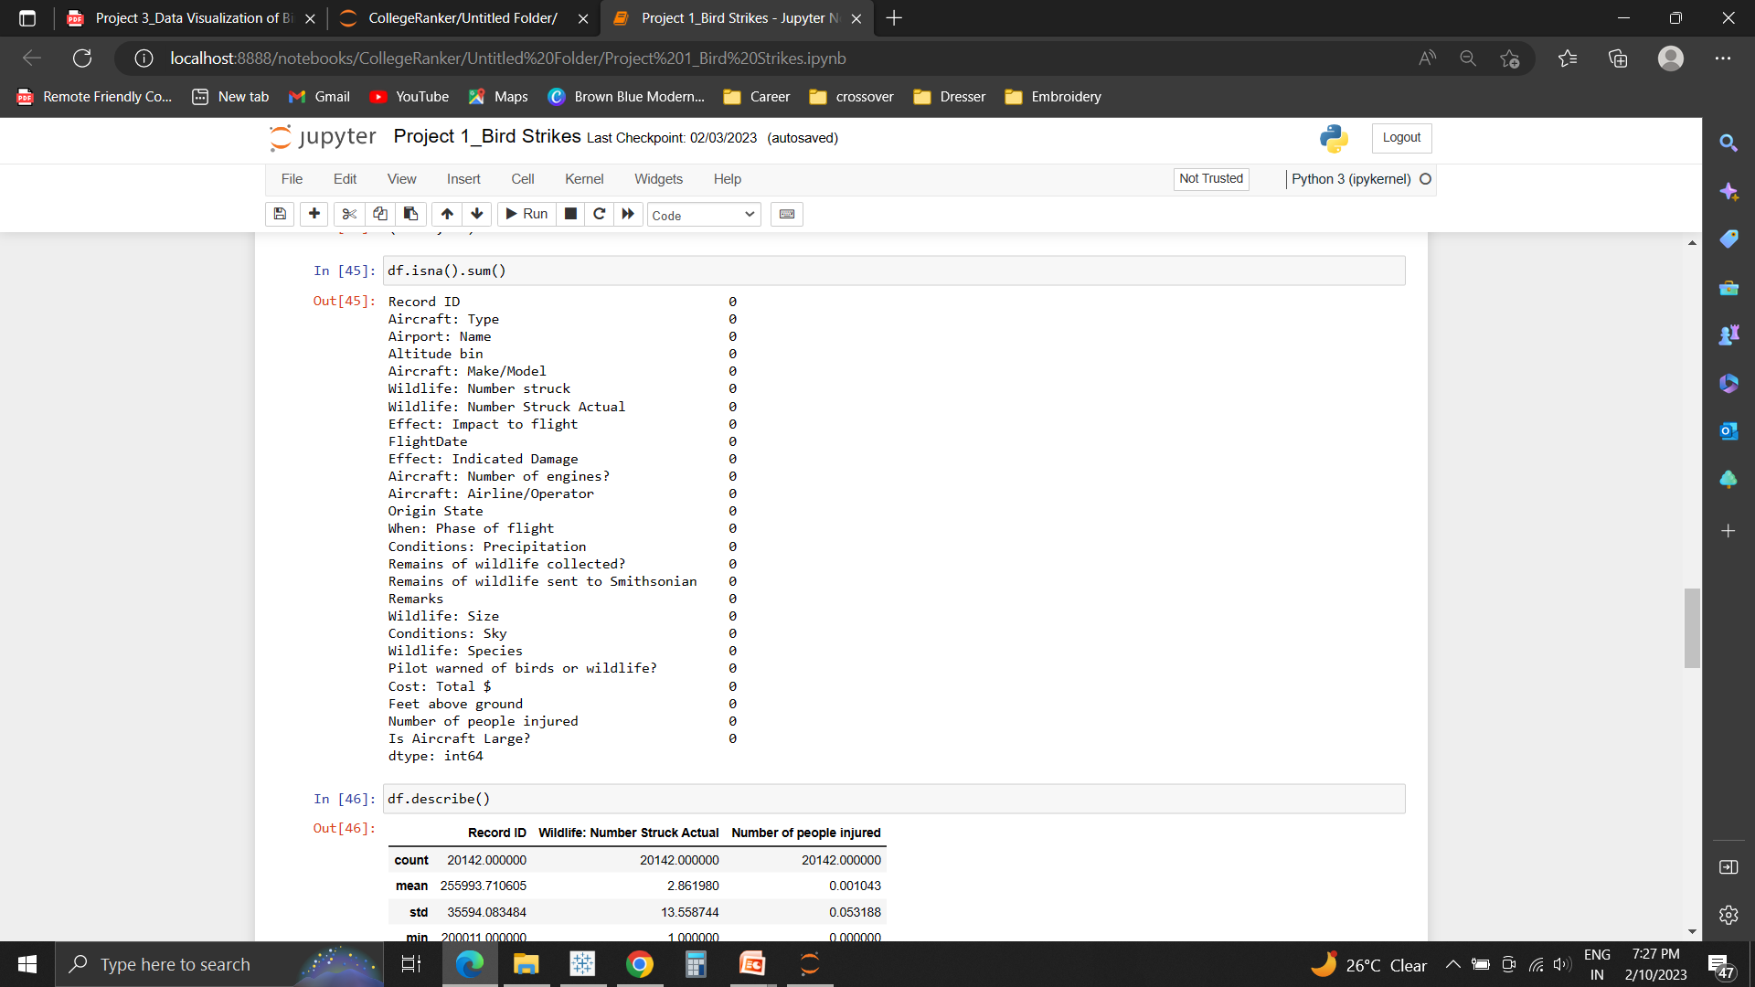
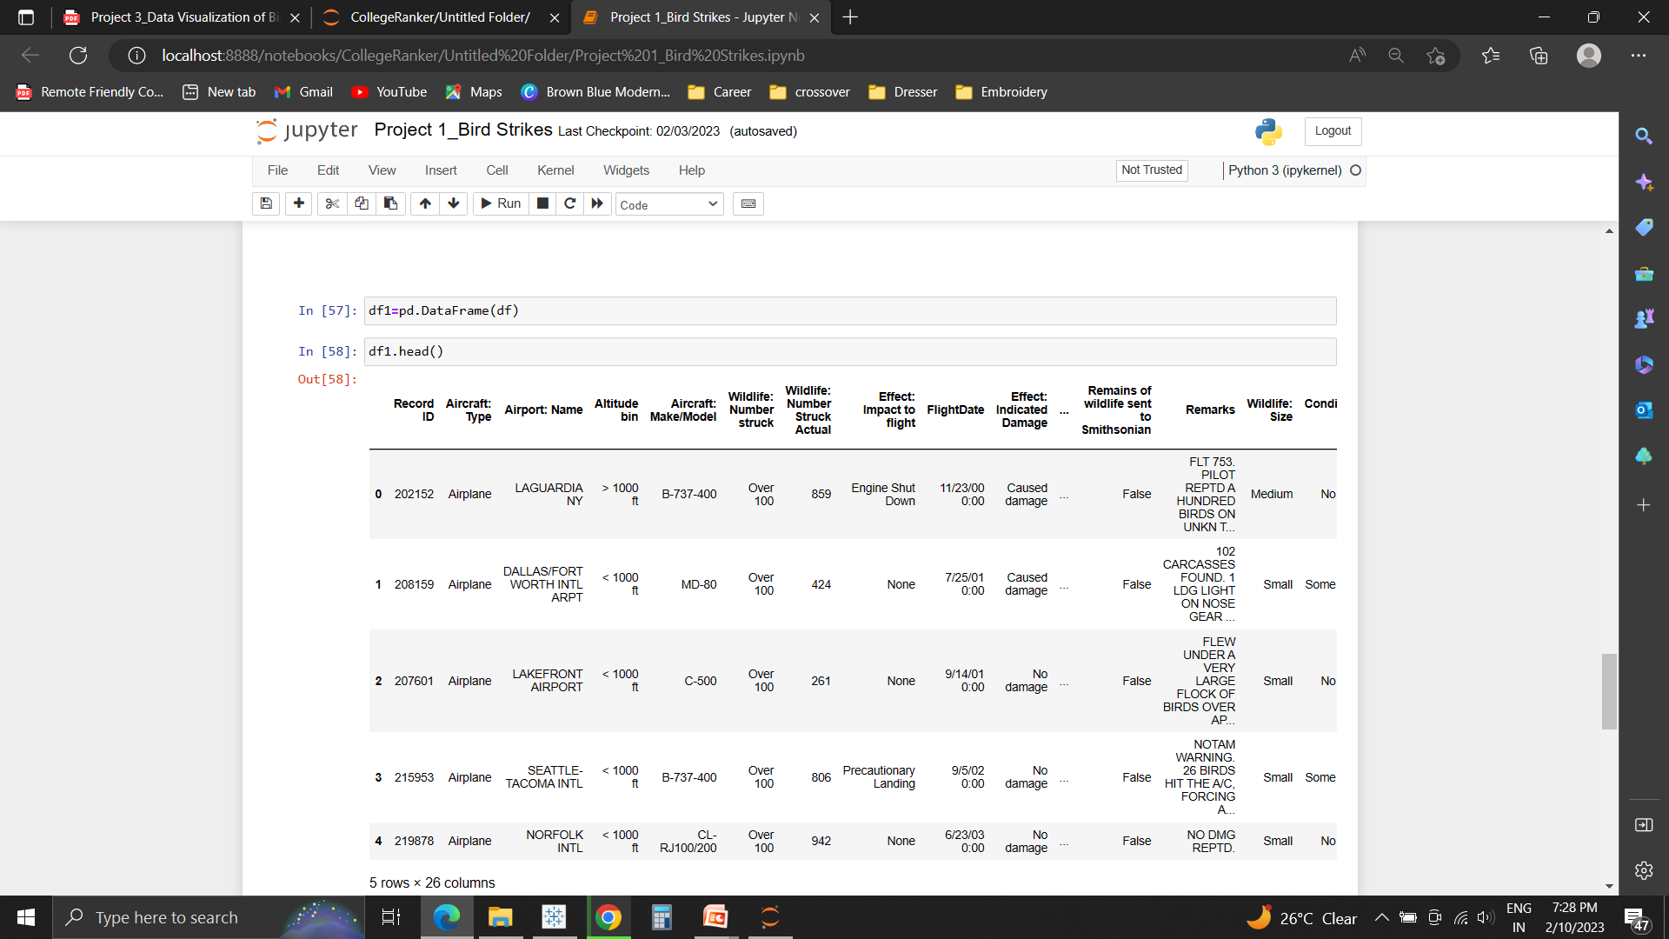
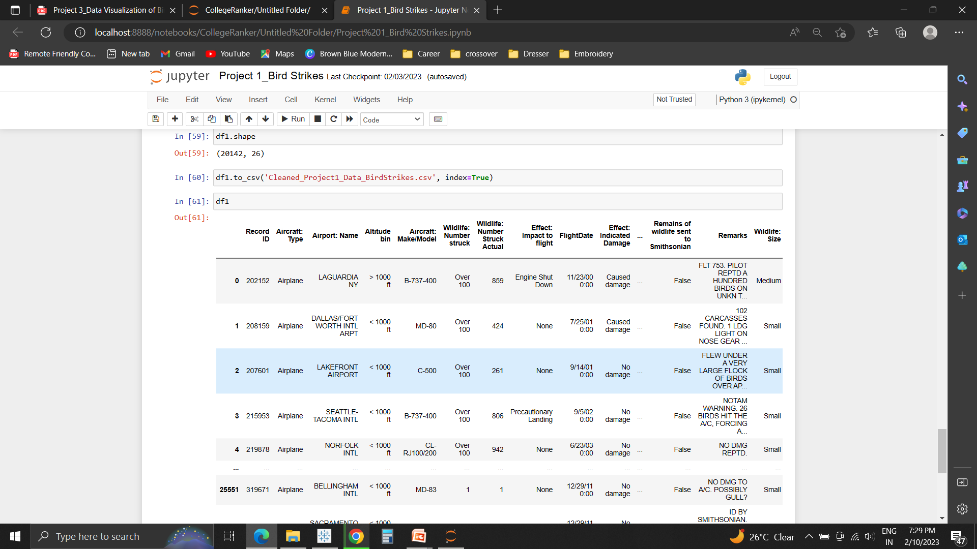
DATA CLEANING
Dataset was first read.
Missing and null values were found and removed using dropna( ) method. (5416 null values were removed, there were no duplicate values)
Cleaned file is downloaded for visual analysis in Tableau.

Slide 6
KEY PERFORMANCE INDICATORS
Impact/Effect on flight due to variation in altitude and environmental conditions.
Phase of Flight, which is directly or indirectly proportional to altitude
Injuries due to fatal accidents: Ultimately, the primary goal of safety above all else is to keep people safe
Species and Size of Birds.

Slide 7
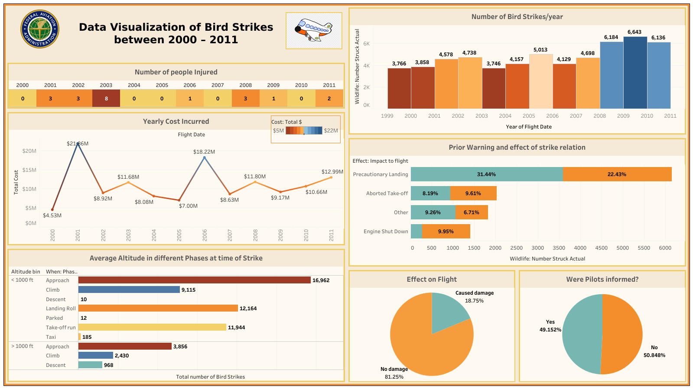

Slide 8
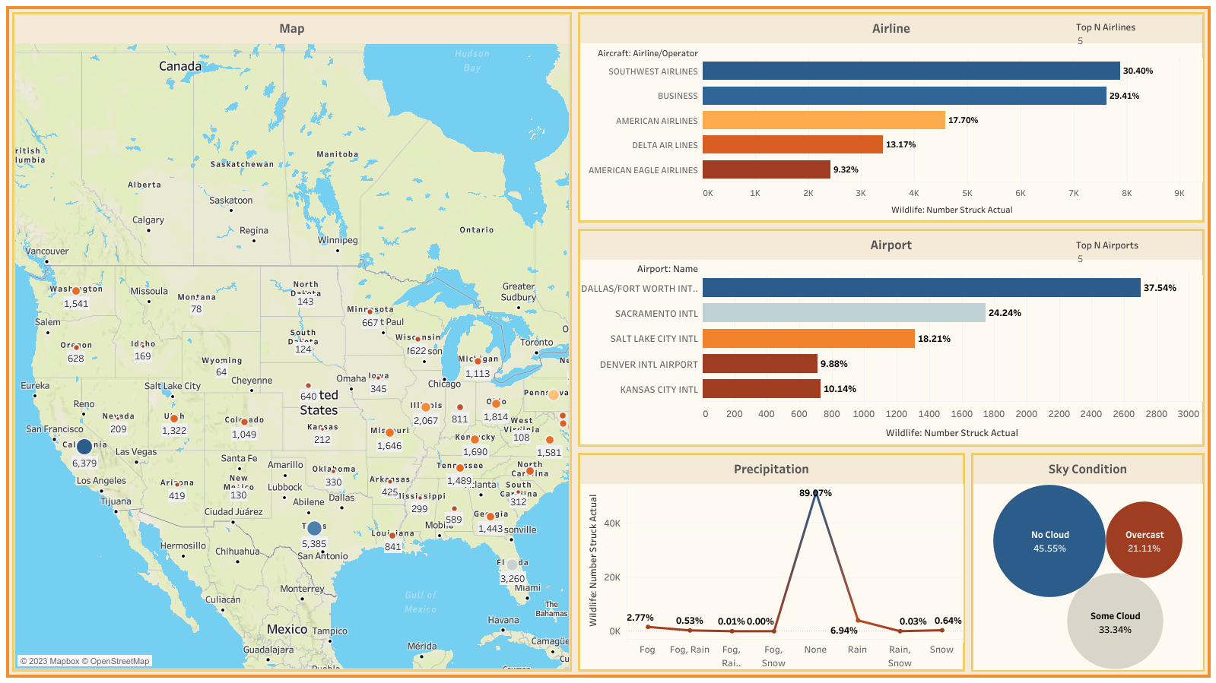

Slide 9
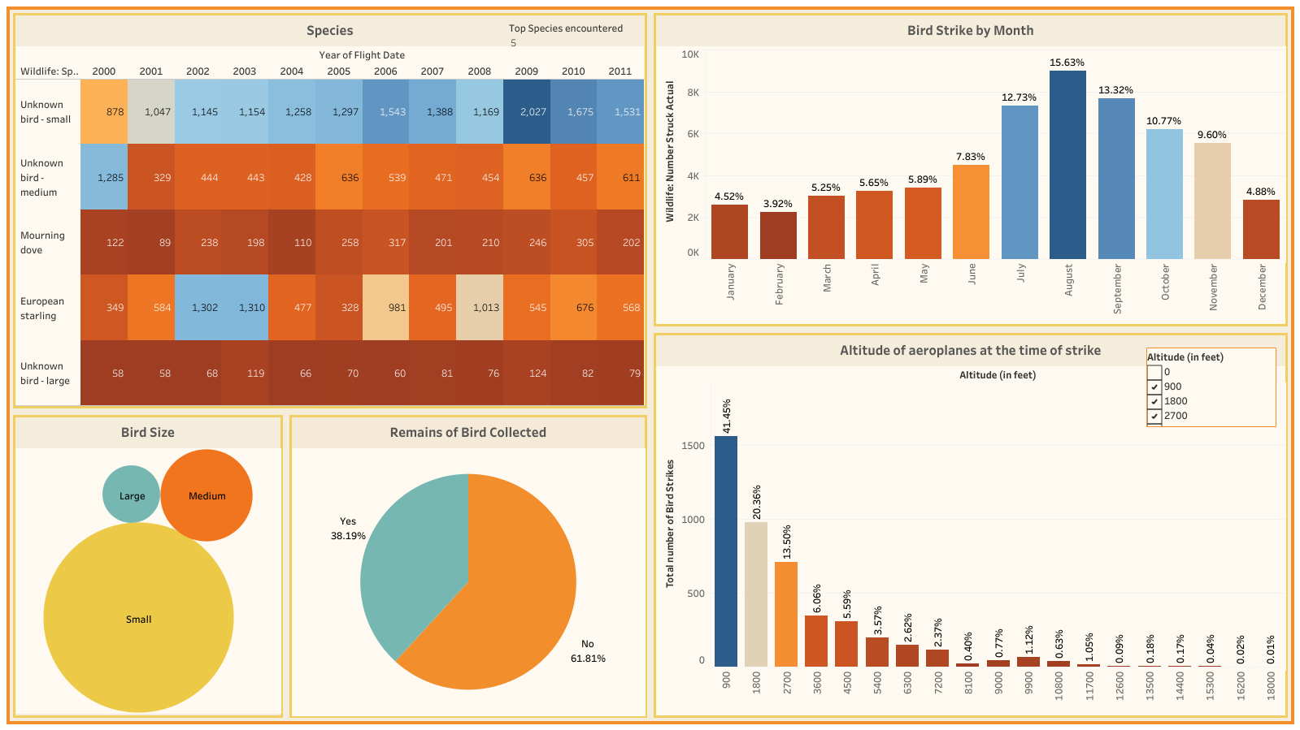

Slide 10
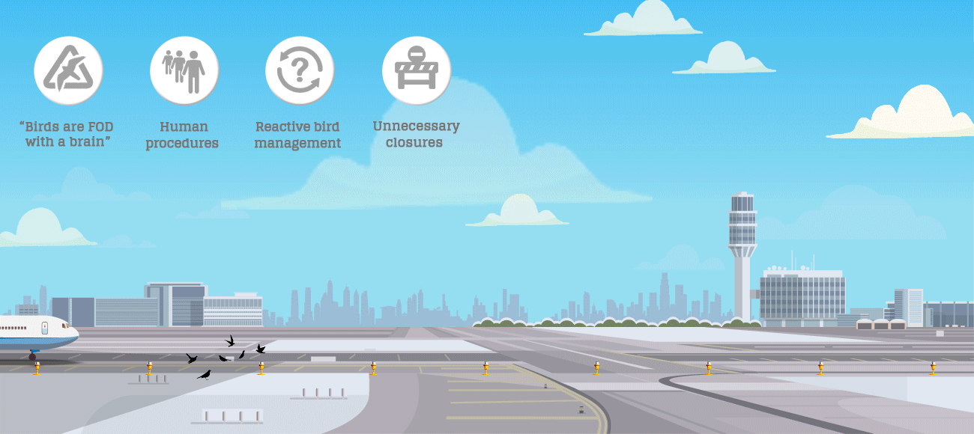
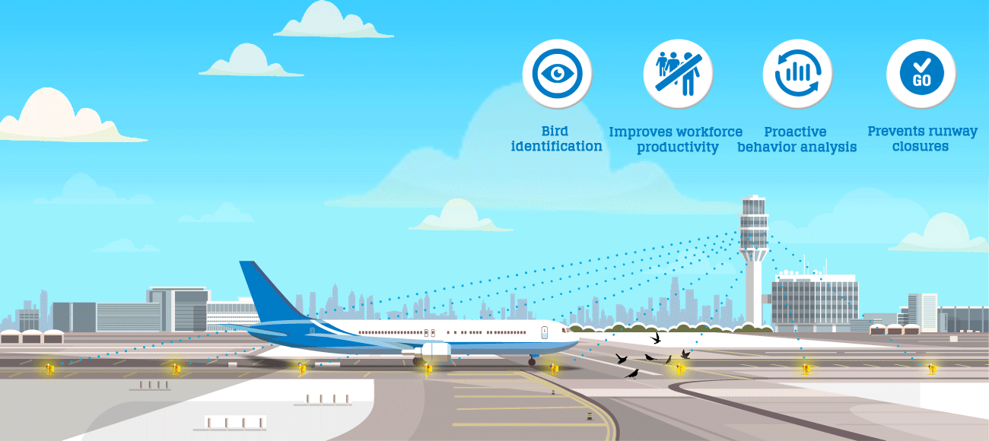
SOLUTIONS THAT CAN BE OFFERED
Modifying Habitat
Remove Seed bearing Plants to eliminate food sources
Remove Bushes and Trees that serve as attractive nesting sites
Use insecticides/ Pesticides to eliminate food sources for insect-eating birds
Modifying Bird Behavior
Use of Noise generators to disrupt Birds
Use of lasers at dawn and dusk to scare them away
Use of trained Falcons/ Dogs in the airport area to teach birds that the area has many predators
Modifying Plane Behavior
Use of radar equipment to track the density and movement of birds.
Adjust flight times to avoid busiest hours to bird activity as per the location.

Slide 11
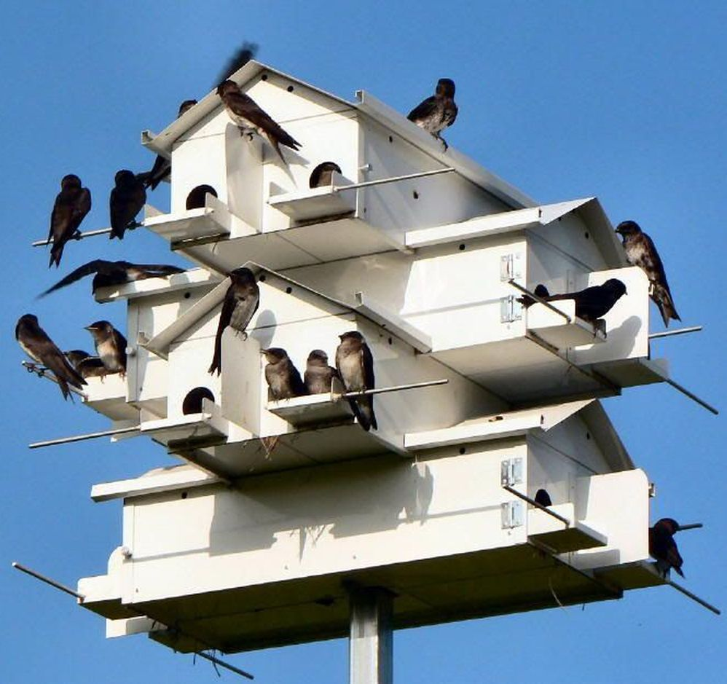
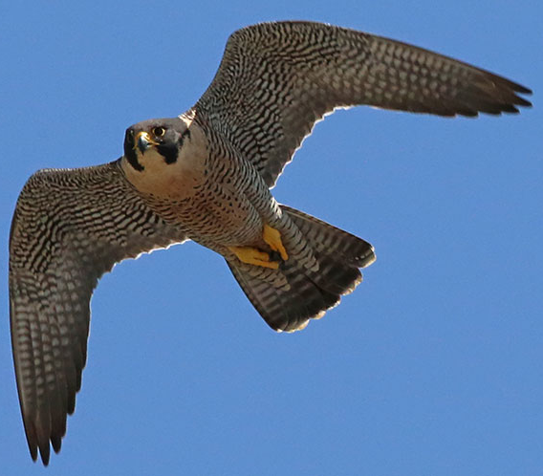
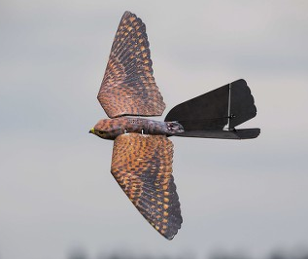
DRAWBACKS & SOLUTIONS/FUTURE SCOPE
Drawbacks:
Habitats of Birds can get affected.
Predators can sometimes themselves be a risk to the aircraft and cause confusion at the runway.
It will require a proper infrastructure, that will be a costly affair.
Restoration of electricity & Broadband might take sometime due to underground cabling
Solutions/Future Scope:
Bird Sanctuary can be set up wherein breeding box will also be a priority.
Bird houses can be built to attract birds
Bird robots in the form of predators can be used.
Proper planning through Data Analysis.
Use of robirds/drones/laser/radar equipment.
Which one is real and which one a robird?

Slide 12
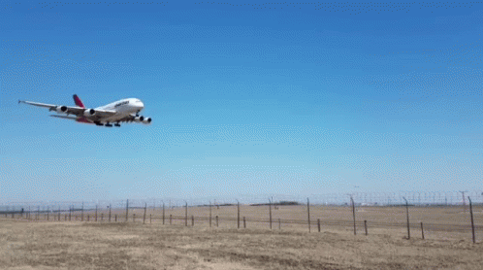
THANK YOU!

